Slide 1
PROFESSIONAL ELECTIVE - 1 APPLIED DATA SCIENCE
MID-1 REVIEW

Slide 2
SUPPLYCHAIN NEXUS
Disruption Propagation & Recovery Planning
CSE – (AI & ML)
SECTION – B
BATCH – 5
TEAM MEMBERS
Jashwanth.R - 24QM1A66A2
Rahul Burdak - 24QM1A66A1
Bharath.C - 25QM1A6605
Internal Expert
Mr. VISHNU VARDHAN
CSE - (AI & ML)
Project Evaluator
Dr. DEVENDER NAYAK N
HOD CSE – (AI & ML)

Slide 3
PROBLEM STATEMENT :
Modern supply chains operate through a complex network of SUPPLIERS, PORTS, TRANSPORTATION ROUTES, FACTORIES AND WAREHOUSES. A disruption at one critical point can propagate through connected operations, resulting in DELAYS, SHORTAGES, INCREASED COSTS AND OPERATIONAL LOSSES. However, organizations often need to understand not only where a disruption occurs, but also how far its impact may spread and what recovery action should be taken.
⚠️ DISRUPTION
NETWORK PROPAGATION
IMPACT
RECOVERY
CORE PROBLEM :
          How can organizations understand the impact of a supply-chain disruption and identify the most suitable recovery strategy using data-driven analysis?

Slide 4
PROBLEM FORMULATION :
DISRUPTION PROPAGATION :
Identify how a disruption at one supply-chain node can affect connected nodes.
IMPACT ASSESSMENT :
Determine the downstream entities, operations and shipments that may be affected.
RISK & DELAY ANALYSIS :
Use historical data and MACHINE LEARNING to estimate relevant disruption risk or operational delay.
RECOVERY PLANNING :
Compare feasible alternatives such as SUPPLIERS, ROUTES, PORTS AND TRANSPORTATION MODES to support recovery decisions.
UNDERSTAND THE DISRUPTION → TRACE THE IMPACT → ESTIMATE THE RISK → PLAN THE RECOVERY

Slide 5
STAKE HOLDERS :
🚢 Supply Chain Managers
🏭 Manufacturers & Distributors
SUPPLY-CHAIN
NEXUS
.
🚚 Logistics & Transportation Operators
🛒 Retailers & Businesses

Slide 6
LITERATURE SURVEY-1 :
S.No. | Study | Year | Method / Focus | Key Finding | Link
1 | The Severity of Supply Chain Disruptions: Design Characteristics and Mitigation Capabilities — Craighead et al. | 2007 | Disruption severity, node criticality | Node criticality, complexity and density influence disruption severity. | Paper
2 | A Digital Supply Chain Twin for Managing the Disruption Risks and Resilience in the Era of Industry 4.0 — Ivanov & Dolgui | 2021 | Digital twin, disruption modelling | Supports supply-chain visibility, disruption analysis and resilience decisions. | Paper
3 | Intelligent Digital Twin (iDT) for Supply Chain Stress-Testing, Resilience, and Viability — Ivanov | 2023 | AI, analytics, decision support | Combines AI, analytics and decision support for disruption and resilience analysis. | Paper

Slide 7
LITERATURE SURVEY-2 :
S.No. | Study | Year | Method / Focus | Key Finding | Link
4 | Enhancing Supply Chain Resilience: A Machine Learning Approach for Predicting Product Availability Dates Under Disruption — Camur et al. | 2024 | Machine Learning | Random Forest and Gradient Boosting performed strongly for predicting product availability under disruption. | Paper
5 | An Intelligent Expert System for Logistics Disruption Prediction and Mitigation in Global Supply Chains — Zhao, Chen & Busababodhin | 2026 | Graph-based risk inference + ensemble forecasting | Combines risk propagation, disruption prediction and mitigation decisions. | Paper
6 | Tipping Point or False Alarm? An Interpretable Machine Learning Framework for Early Warning of Supply Chain Disruptions Under Multi-Source Uncertainty — Wang, Guo & Shi | 2026 | Interpretable ML + early warning | Uses interpretable machine learning to identify disruption warning signals under uncertain conditions. | Paper

Slide 8
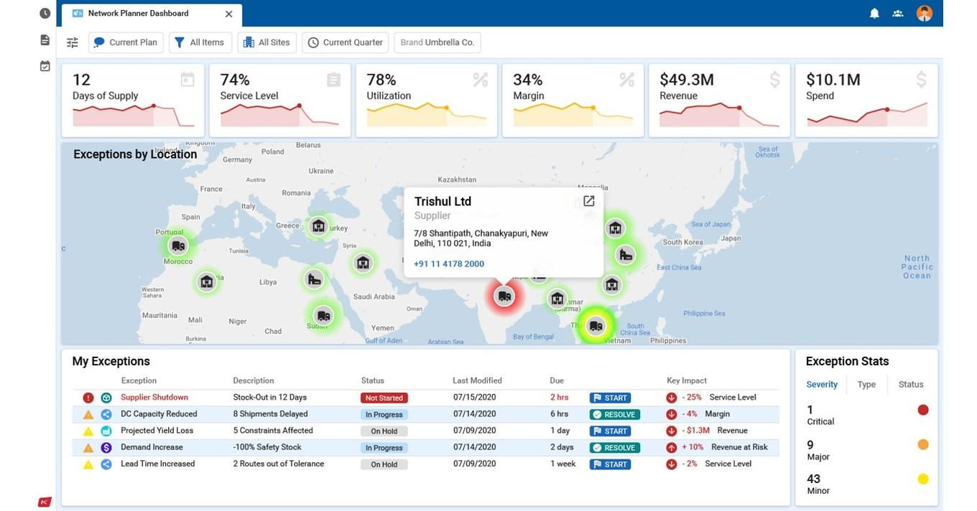
EXISTING SYSTEMS :
Supplier Risk Monitoring — Tracks supplier performance and risks.
Shipment Visibility — Monitors shipment status and delivery progress.
Disruption Alerts — Identifies operational disruptions and exceptions.
Delay Prediction — Estimates potential delivery or operational delays.
Route Optimization — Helps identify efficient transportation routes.
Network Mapping — Provides visibility into connected supply-chain entities.
AI/ML Analytics — Supports risk assessment and operational decisions.
LIMITATION: Existing solutions often address individual functions rather than connecting DISRUPTION → PROPAGATION → IMPACT → RECOVERY in one workflow.

Slide 9
PROPOSED SYSTEM :
Unified Data Integration — Combines supply-chain, transportation and disruption data into one analytical system.
Disruption Propagation Analysis — Uses network relationships to trace how a disruption can spread across connected nodes.
Impact Assessment — Identifies potentially affected suppliers, routes, facilities and downstream operations.
ML-Based Risk Analysis — Uses historical data to estimate relevant disruption risks or operational delays.
Recovery Planning — Compares feasible alternatives such as suppliers, routes, ports and transportation modes.
Decision Support — Presents the impact and recovery options through interactive dashboards and a Streamlit interface.

Slide 10
SYSTEM REQUIREMENTS :
Functional Requirements | Non-Functional Requirements
Data integration from multiple sources | Accuracy of analytical results
Supply-chain disruption analysis | Performance for efficient processing
Disruption impact assessment | Scalability for larger datasets
ML-based risk / delay prediction | Usability of dashboards and interface
Recovery alternative comparison | Maintainability of system modules
Power BI & Streamlit visualization | Reliability across scenarios

Slide 11
TECH STACK :
Technology | Purpose
Python | Data analysis & machine learning
Pandas / NumPy | Data cleaning & processing
Scikit-learn | ML model development
NetworkX | Supply-chain network analysis
MySQL | Data storage & management
Power BI | Analytics & dashboards
Streamlit | Interactive decision-support interface
VS Code | Development environment

Slide 12
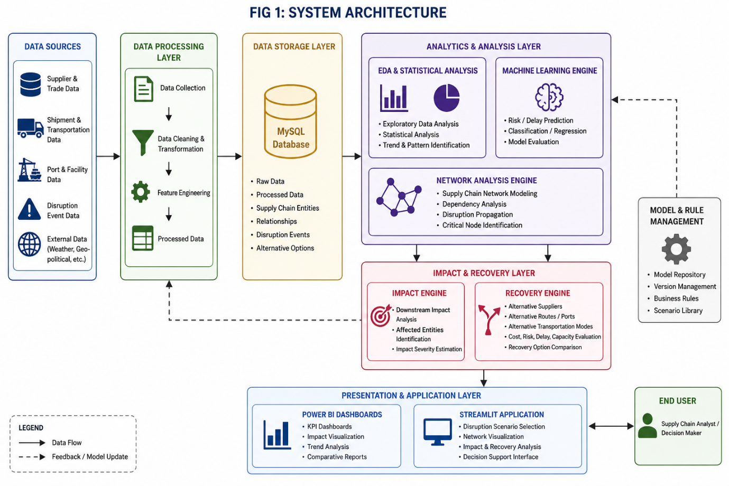
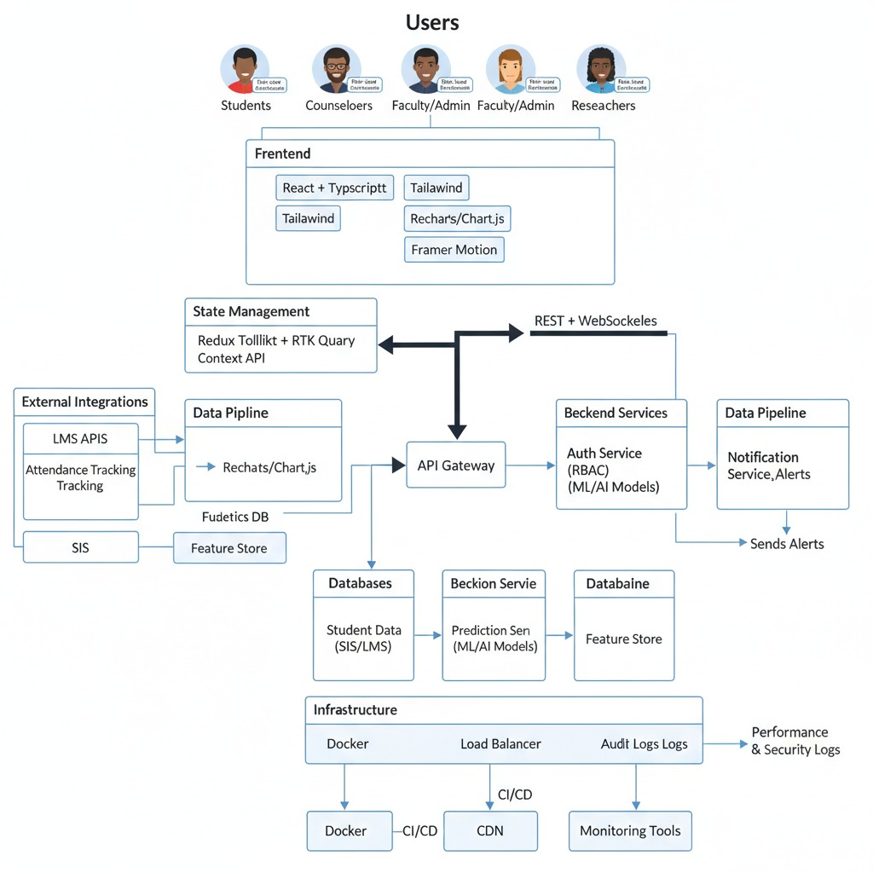
SYSTEM ARCHITECTURE :

Slide 13
CONCLUSION :
SupplyChain Nexus addresses the challenge of understanding how supply-chain disruptions propagate across interconnected operations.
The proposed system combines DATA ANALYSIS, MACHINE LEARNING AND NETWORK ANALYSIS to assess disruption impact.
It further supports RECOVERY PLANNING by comparing feasible alternatives for disrupted supply-chain operations.
The proposed architecture and requirements establish the foundation for the IMPLEMENTATION AND EVALUATION phase.

Slide 14
“Your Attention is Greatly Appreciated”
Thankyou ✨
~ TEAM 5

